Slide 1
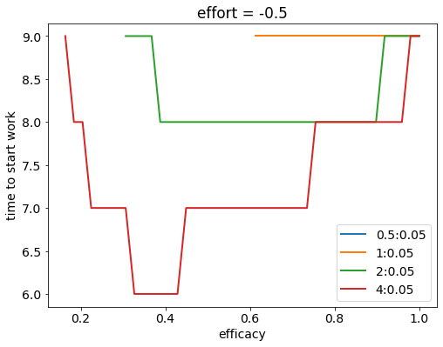
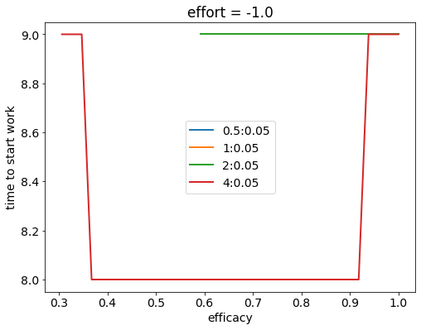
N = 10 and discount factor = 0.9 (always)
Punishment = 0;
Only reward for task completion (and smaller reward for distraction)

Slide 2
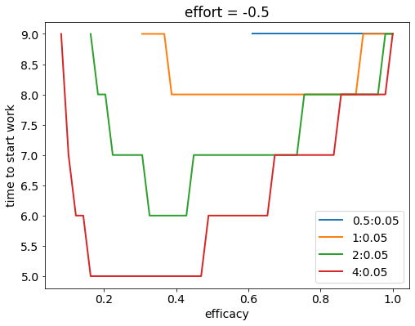
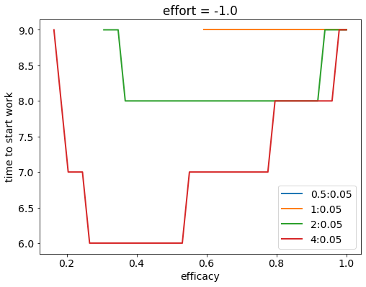
Punishment = -Reward (on task completion);
(and smaller reward for distraction)

Slide 3
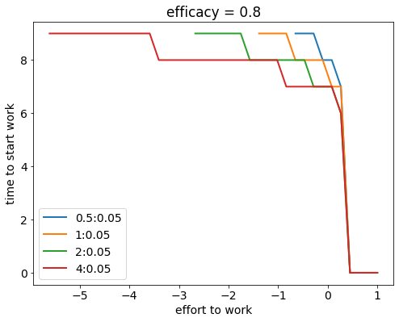
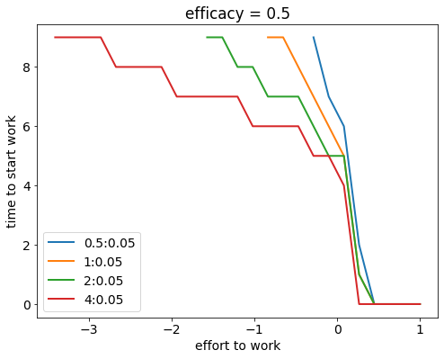
Effects of effort (reward = punishment magnitude)

Slide 4
Why is it optimal to continue working once working becomes optimal

Slide 5
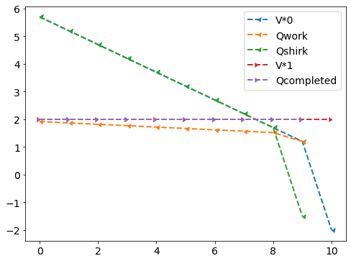
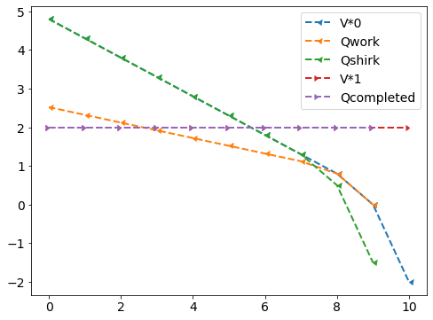
Reward (pass, fail, shirk) = 2, -2, 0.5; effort (work, shirk) = -0.4, 0
Discount_factor = 1.0 (no discounting future value)
reward_completed = 0
efficacy = 0.9
efficacy = 0.6

Slide 6
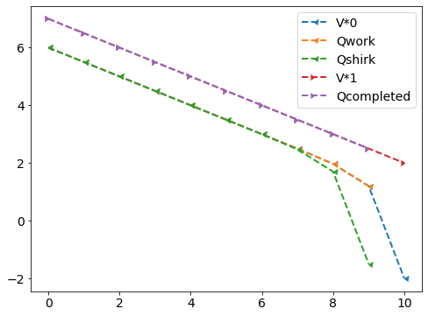
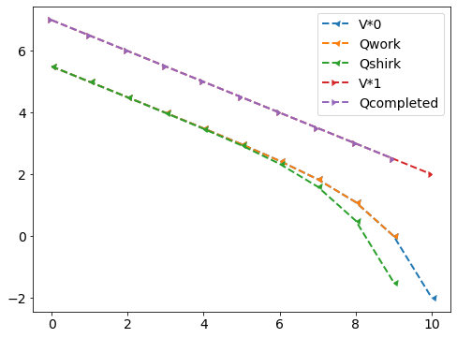
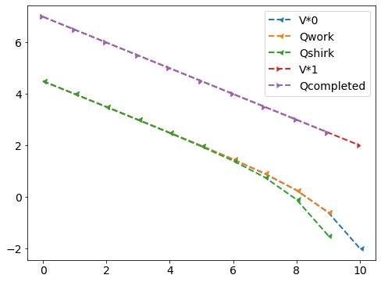
Discount_factor = 1.0 (no discounting future value)
reward_completed = reward_shirk
efficacy = 0.9, effort = -0.4
efficacy = 0.6, effort = -0.4
efficacy = 0.6, effort = -1.0

Slide 7
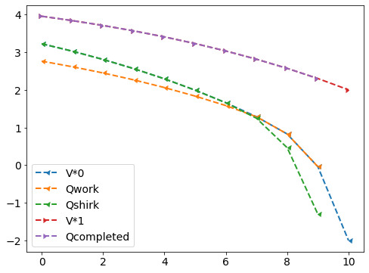
Discount_factor = 0.9
reward_completed = reward_shirk, efficacy = 0.9, effort = -0.4

Slide 8
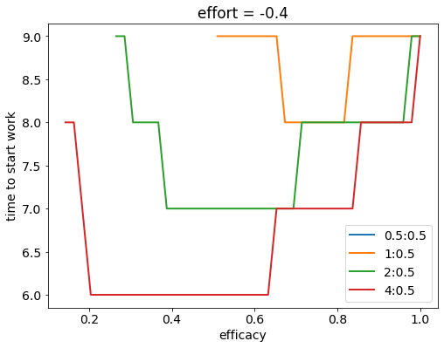
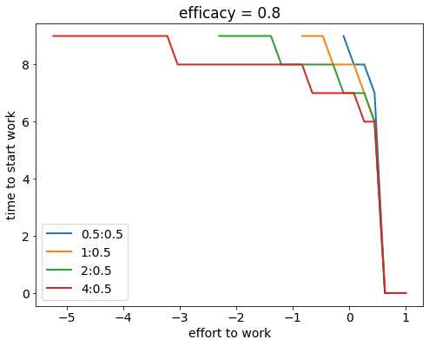
With rewards on completing, the reward_shirk doesn’t have to be very small for it to be worth working ; but qualitatively similar results as before
Discount = 0.9, N = 10

Slide 9
Including an intermediate state

Slide 10
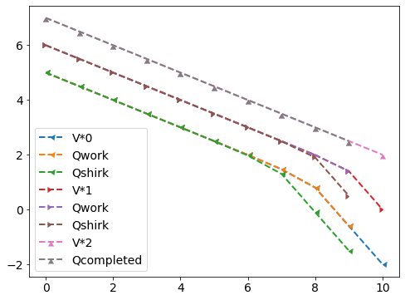
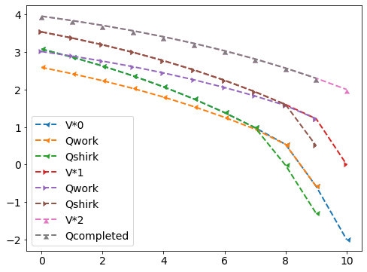
Reward (pass, fail, shirk) = 2, -2, 0.5; effort (work, shirk) = -0.4, 0
Efficacy = 0.9
Discount = 1.0
Discount = 0.9

Slide 11
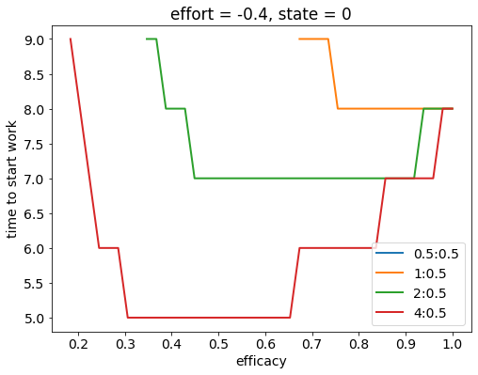
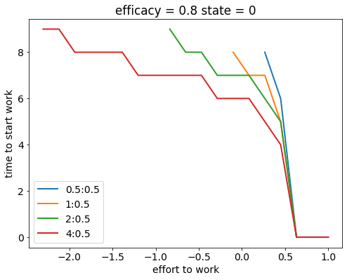
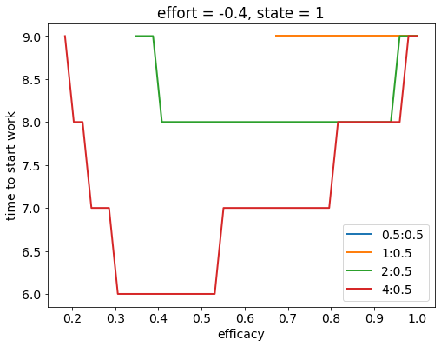
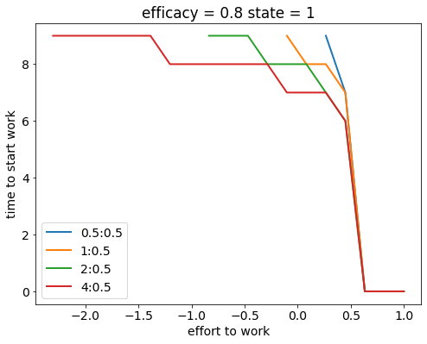
Reward_pass = -reward_fail; discount = 0.9

Slide 12
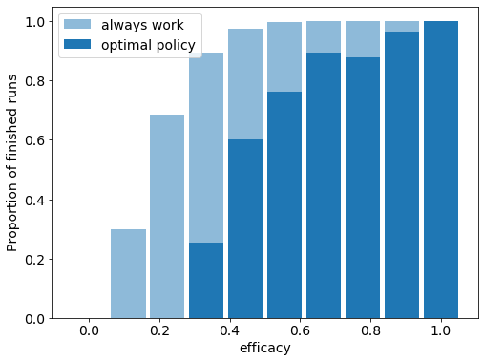
Here, procrastination comes from delaying starting even if that leaves a possibility of not completing Forward runs:
Reward (pass, fail, shirk) = 4, -4, 0.5; effort (work) = -0.4; N_runs=5000

